Slide 1
2017 Libby Dam Kootenai Sturgeon Operations
2017 TMT End of Year
Jason Flory
US Fish & Wildlife Service

Slide 2
2017 Conditions
May final April-August runoff volume: 8.19 MAF
139% of average
Tier 5 under Libby Biological Opinion
1.2 MAF for sturgeon volume
Bull trout minimum flow: 9 kcfs

Slide 3
Sturgeon operations
Two-pulse operation
First pulse intended to trigger upstream migration and staging
Began May 15, lowered May 21
Cold water
Second pulse intended to trigger further upstream migration and spawning towards end of peak
Began June 2, concerns over flood risk reduced planned Libby releases at start (to 22 kcfs)
Descending limb began June 11, volume exhausted June 19
Warmer water released towards end of second pulse

Slide 4
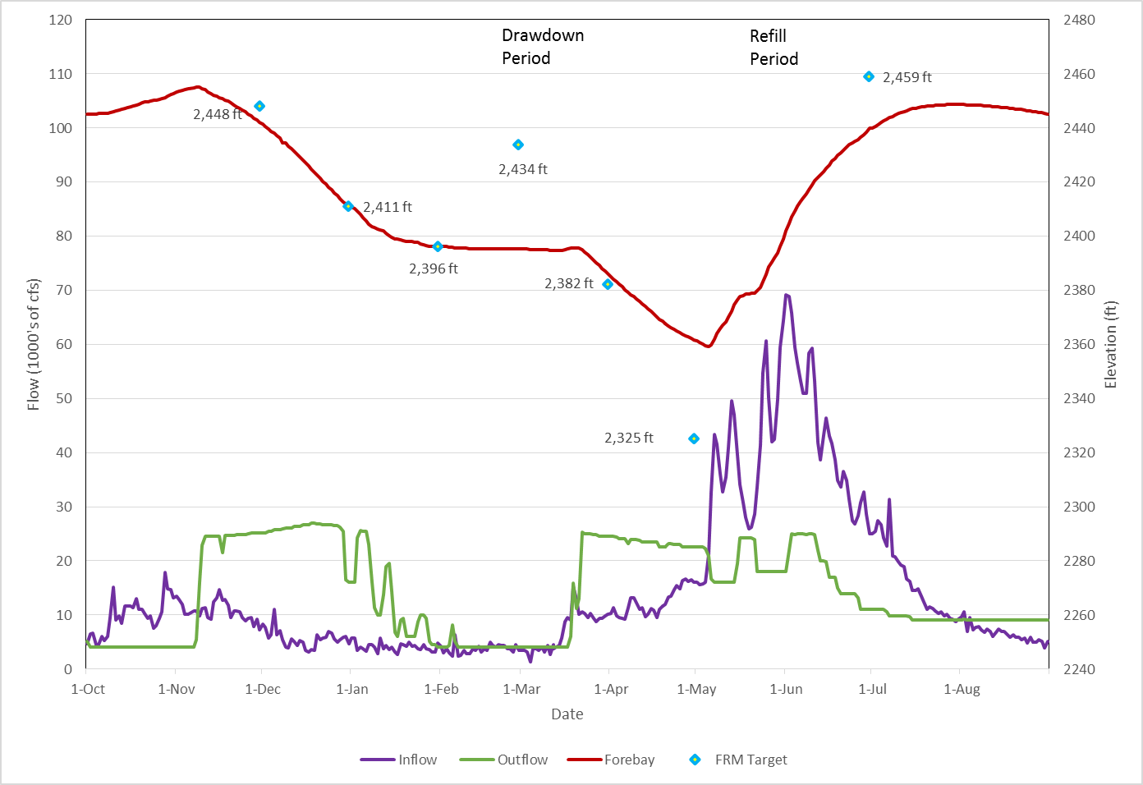

Slide 5
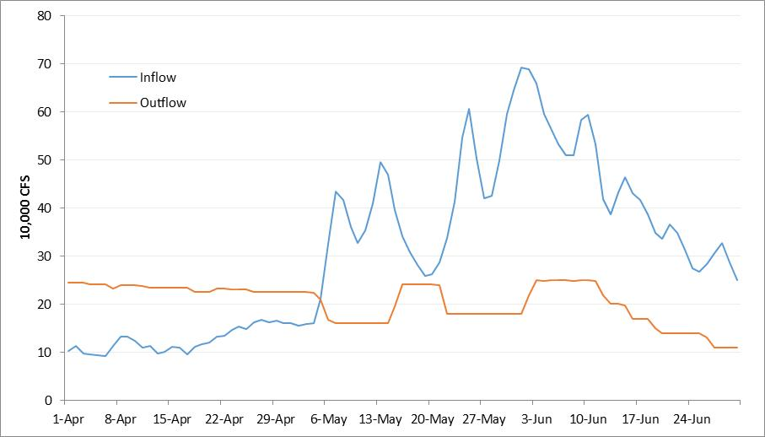

Slide 6
Sturgeon Response
IDFG telemetry data shows a 20% increase (above previous 5-year average) in the number of tagged adult sturgeon that migrated upstream of Bonners Ferry
Flow management, habitat project, both, or something else?
Regardless, it’s a good situation to be in!

